Slide 1

Warehouse Management System

Slide 2

The Mini Project Is Presenting By :-
AKSHAY M KALABURGI

Slide 3
Content :
Introduction of SQL
Introduction of PL/SQL
Objective
Abstract
Planning Phase
System Requirements
Design Phase
ER Diagram
Schema Diagram
Tables
Tables Creation & Insertion
Summary

Slide 4
Introduction to SQL :
It is a Fourth Generation Language (The syntax are pretty simple & words are not abbreviated)
SQL stands for Structured Query Language.
SQL is used to create, remove, alter the database and database objects in a database management system and to store, retrieve, update the data in a database.
SQL is a standard language for creating, accessing, manipulating database management system.
Benefits of SQL are :
It is a non-procedural language.
It is a language for all users.
It is unified language.

Slide 5
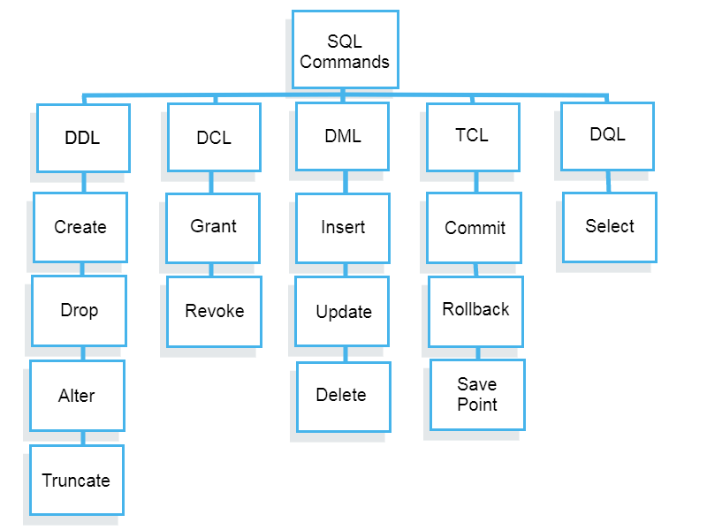
SQL Concept Figure :

Slide 6
Introduction to PL/SQL :
PL/SQL is Oracle’s Procedural Language extension to SQL.
PL/SQL is a part of the Oracle Database Server.
Data manipulation and query statements of SQL are included within procedural units of code.
PL/SQL statements are executed by the Procedural Statement Executor & the SQL statements are executed by the SQL Statement Executor
Benefits of PL/SQL are :
Better Performance
Standard and Portable Language
Several SQL statements can be bundled together into one PL/SQL block of and sent to the server as a single unit.

Slide 7
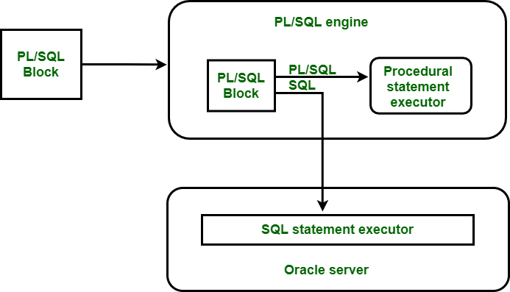
PL/SQL Concept Figure :

Slide 8
Objective :
Designing the Database
Developing the queries
Solving the problems
Basic reports required for “WAREHOUSE MANAGEMENT SYSTEM”.

Slide 9

Abstract Of The Project:
A warehouse management system (WMS) is a software solution that offers visibility into a business' entire inventory and manages supply chain fulfillment operations from the distribution center to the store shelf.
Warehouse management is the process, control, and optimization of warehouse operations from the entry of inventory into a warehouse — or multiple warehouses — until items are moved, sold, or consumed.
Database driven computer application, to improve the efficiency of the warehouse by directing cutaways. and to maintain accurate inventory by recording warehouse transactions.

Slide 10
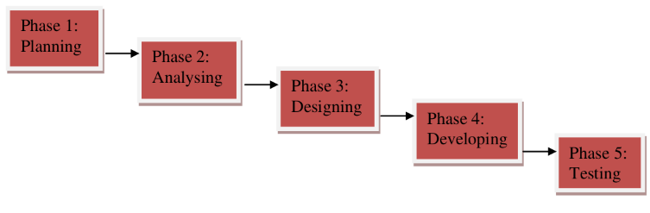
Planning Phase :

Slide 11

System Requirements :
Physical Memory (RAM) - 1 GB Minimum
Virtual Memory - Double the amount of RAM
Disk space - Total 5 GB
Processor - 550 MHz minimum
Video Adapter - 256 colors

Slide 12
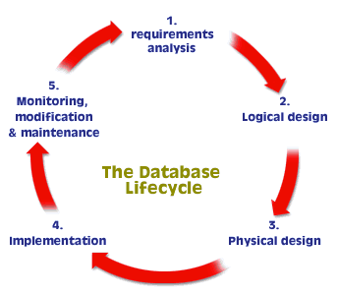
Design Phase :

Slide 13
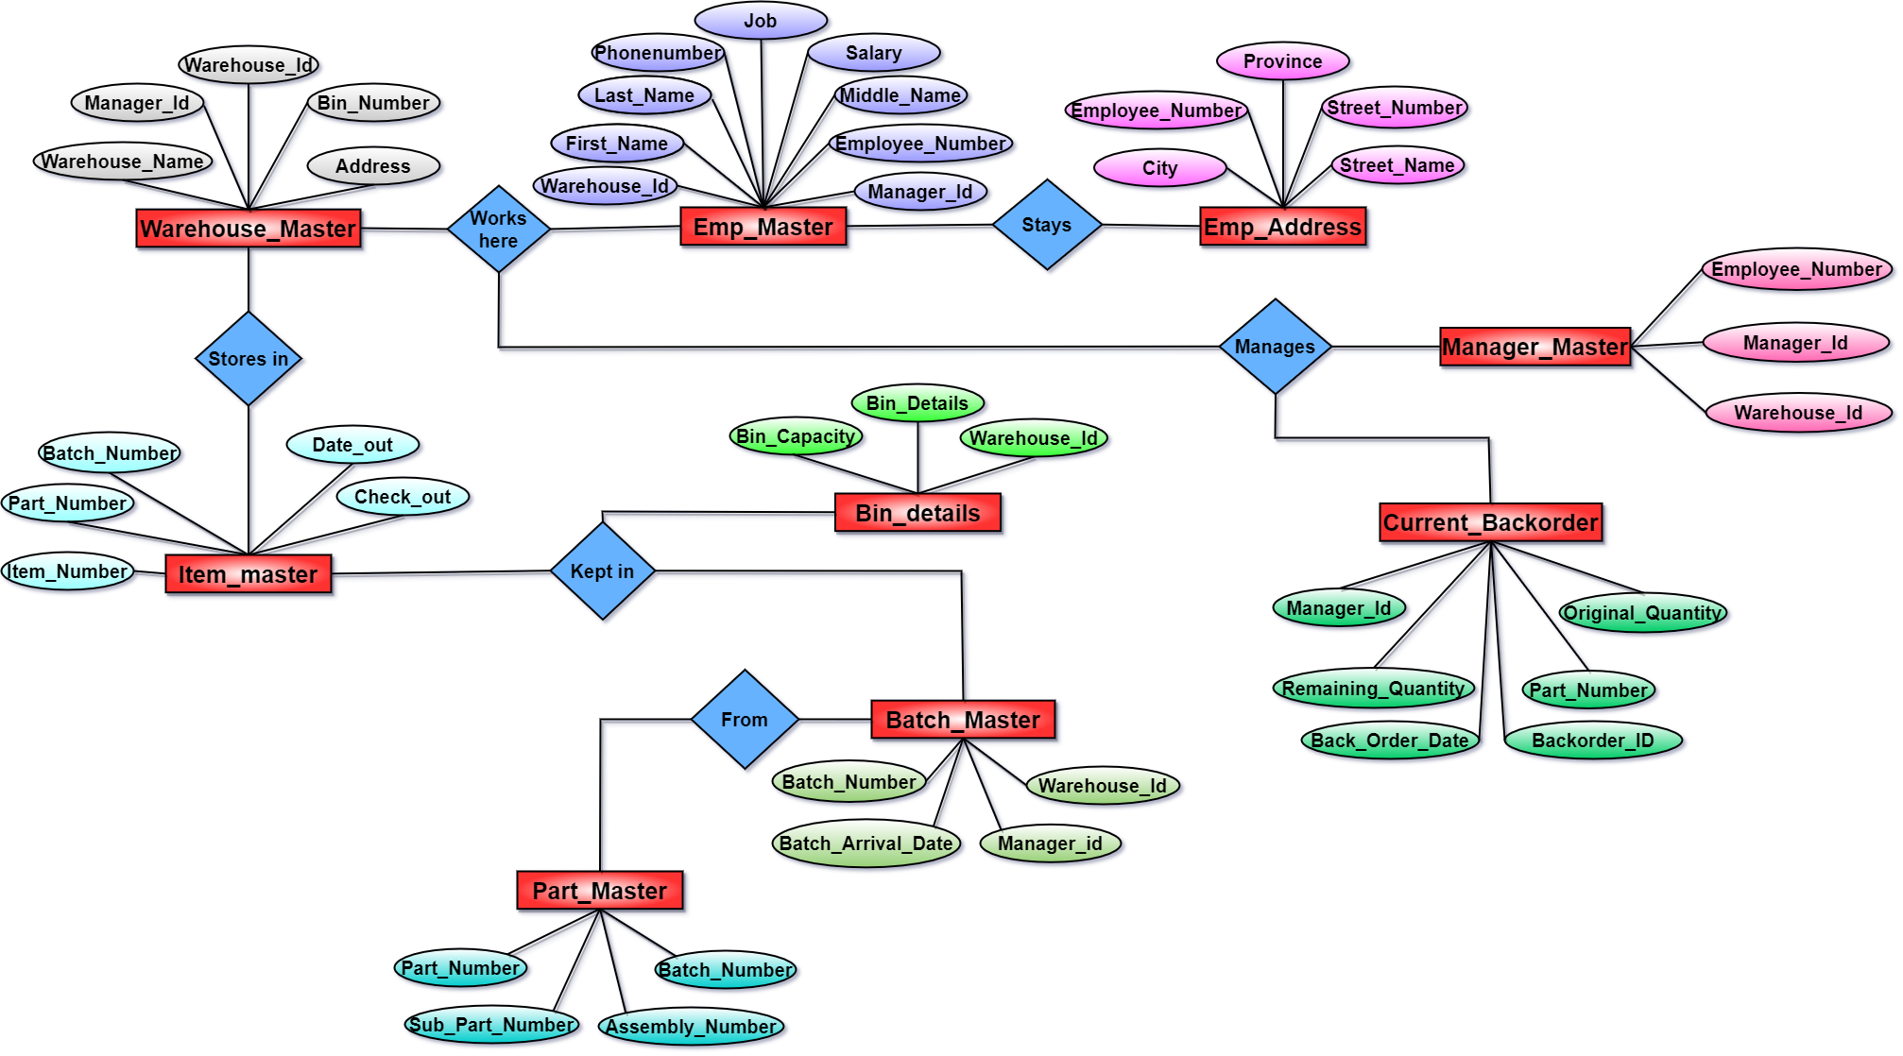
Entity Relationship Diagram Of WAREHOUSE MANAGEMENT SYSTEM :

Slide 14
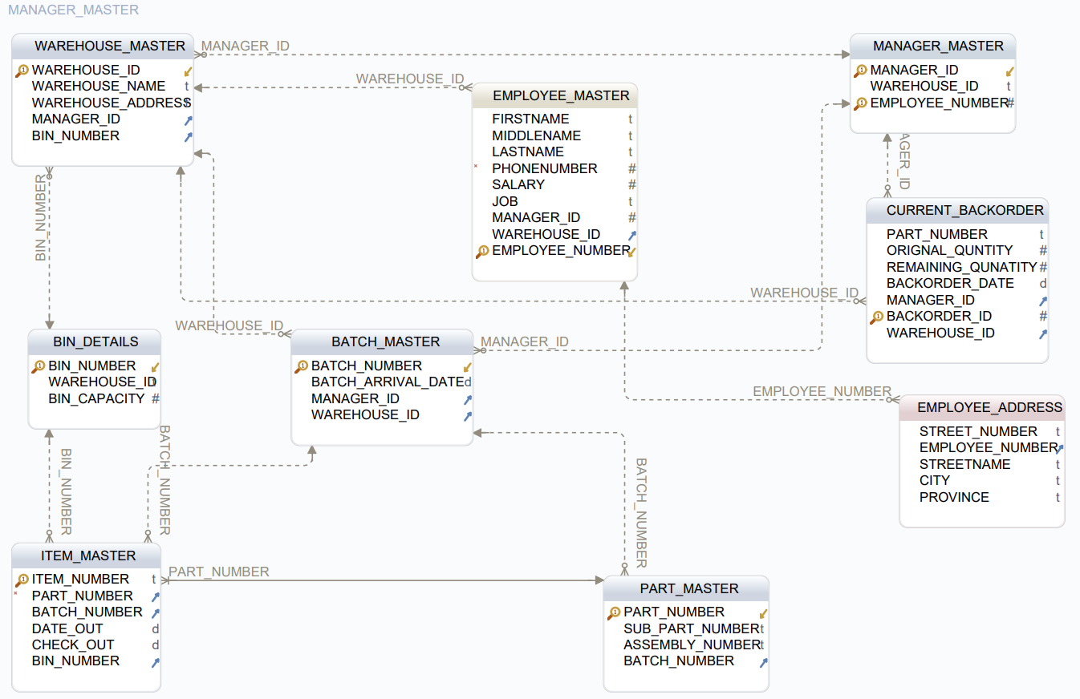
Schema Diagram :

Slide 15
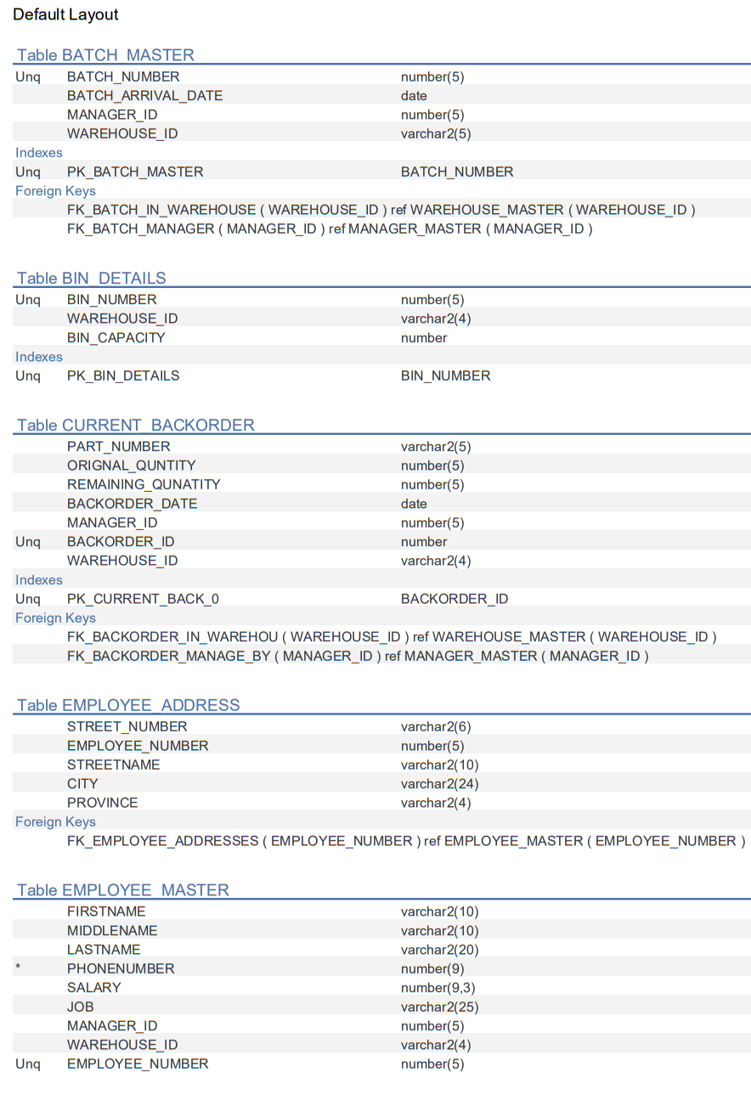
TABLES :

Slide 16
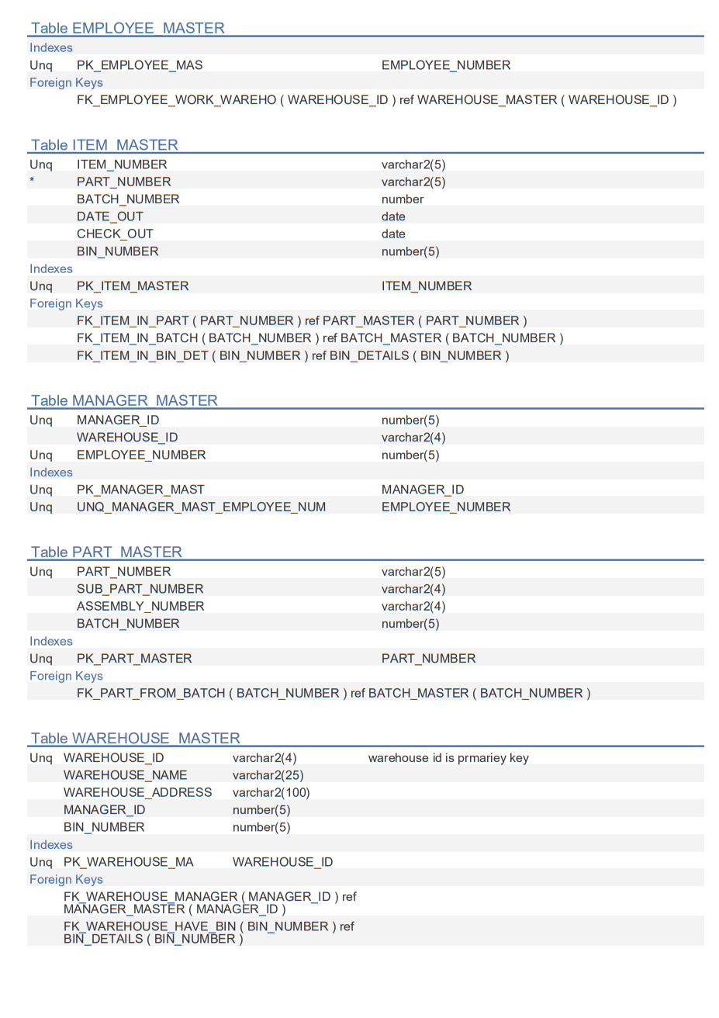
TABLES :

Slide 17
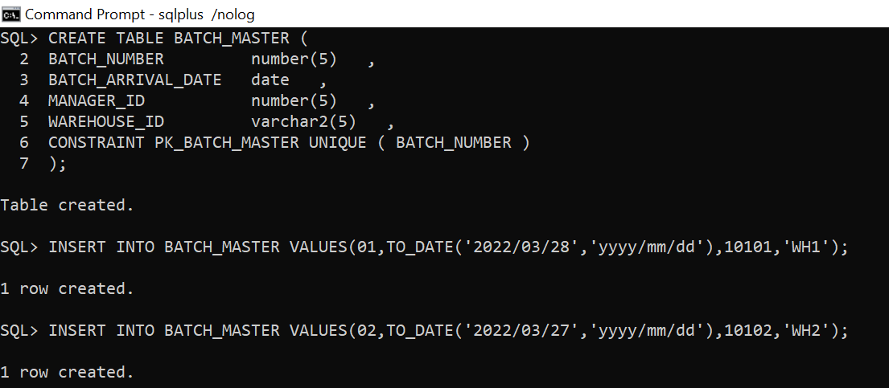
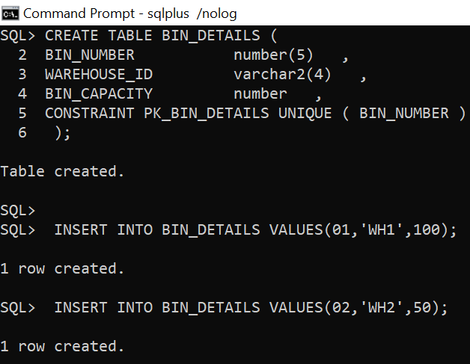
Table Creation and Insertion :
BatchMaster Table :
BatchNumber, ArrivalDate,
ManagerId, WarehouseId
BinDetails :
BinNumber, Warehouse_Id

Slide 18
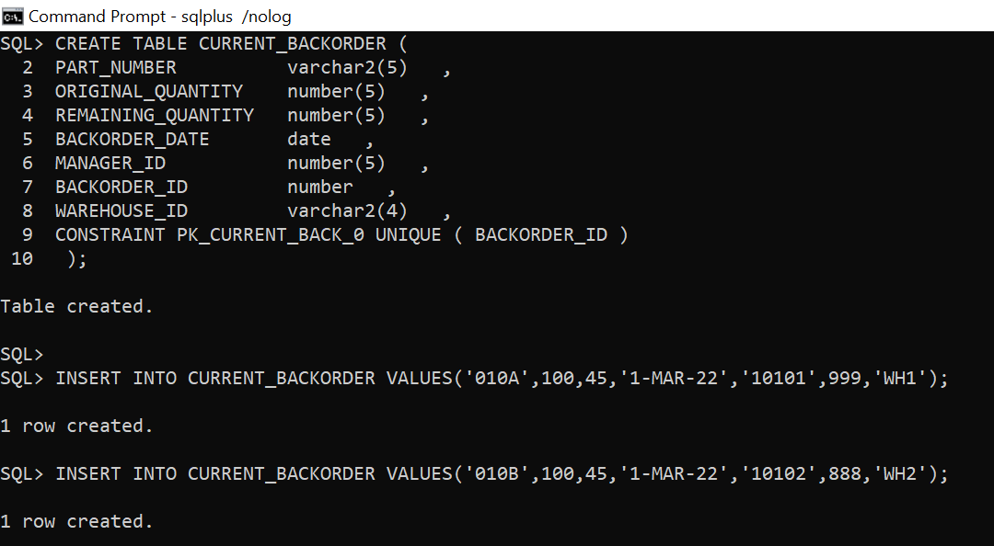
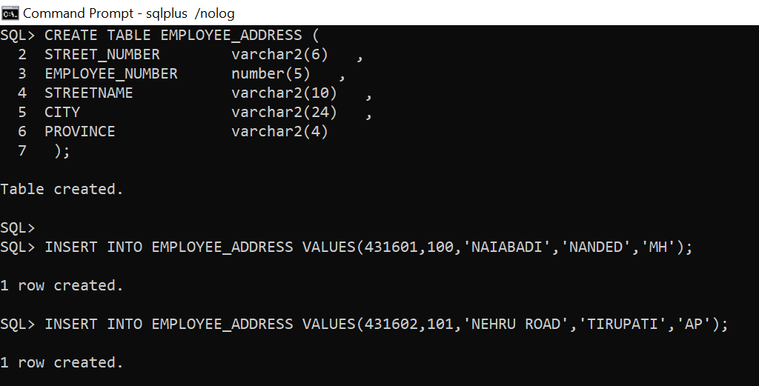
Table Creation and Insertion :
CurrentBackorder :
PartNumber, OriginalQuantity, RemainingQuantity, BackorderDate, ManagerId
Employee Address :
StreetNumber, EmployeeNumber, Streetname, City, Province

Slide 19
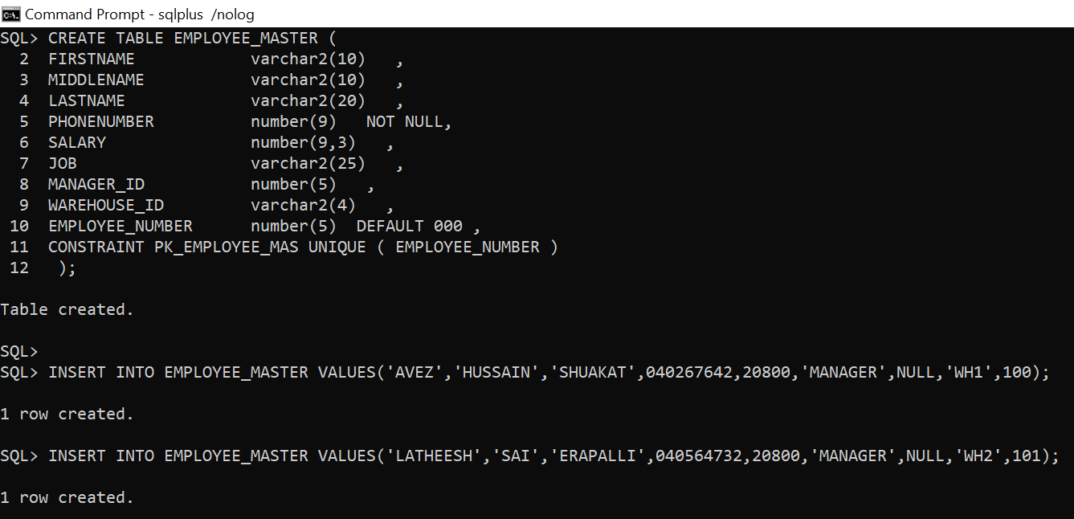
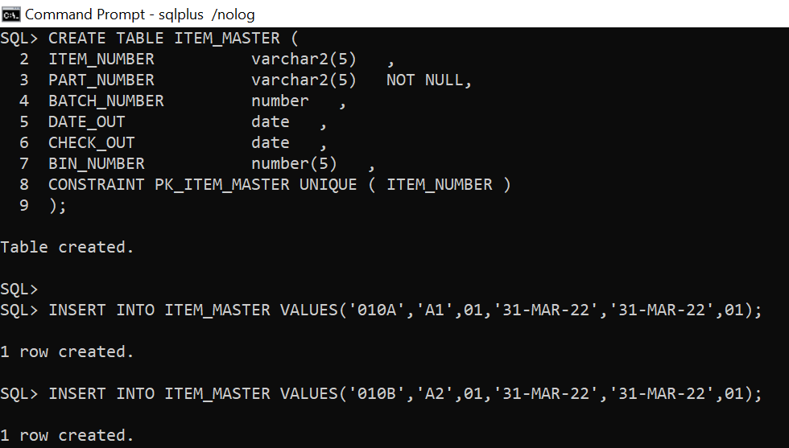
Table Creation and Insertion :
EmployeeMaster :
EmployeeNumber, FirstName, MiddleName, LastName, PhoneNumber, Salary, Job, ManageId, WarehouseId
ItemMaster :
ItemNumber, PartNumber, BatchNumber, DateOut, CheckedOut

Slide 20
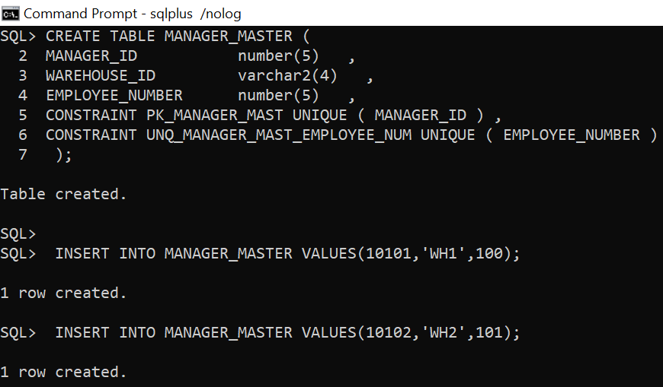
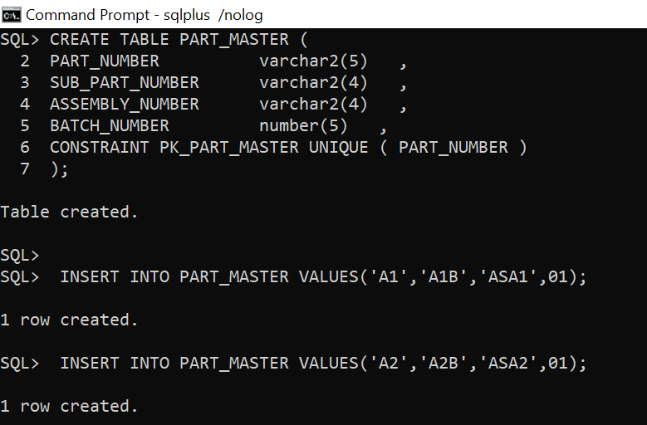
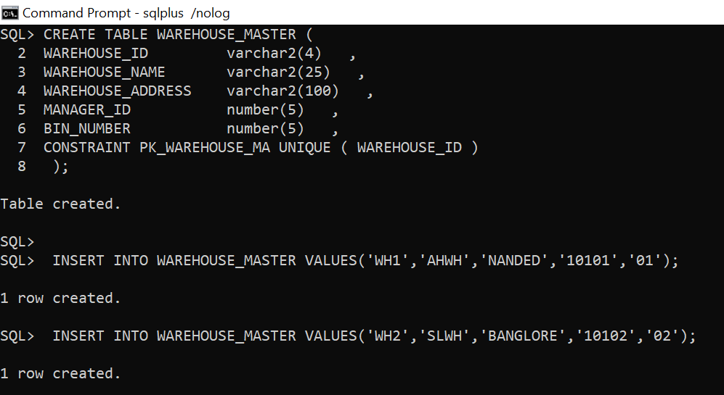
Contd….
ManagerMaster :
ManagerId, EmployeeNumber, WarehouseId
PartMaster :
PartNumber, SubPartNumber, AssemblyNumber, BatchNumber
WarehouseMaster :
WarehouseId, WarehouseName, WarehouseAddress, ManagerId,
BinNumber

Slide 21

PROCEDURES

Slide 22
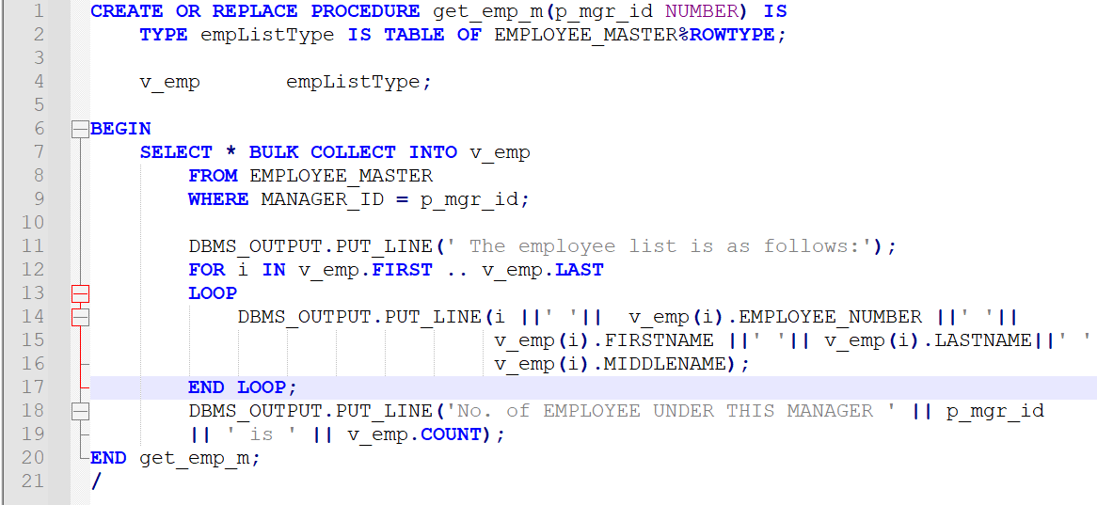
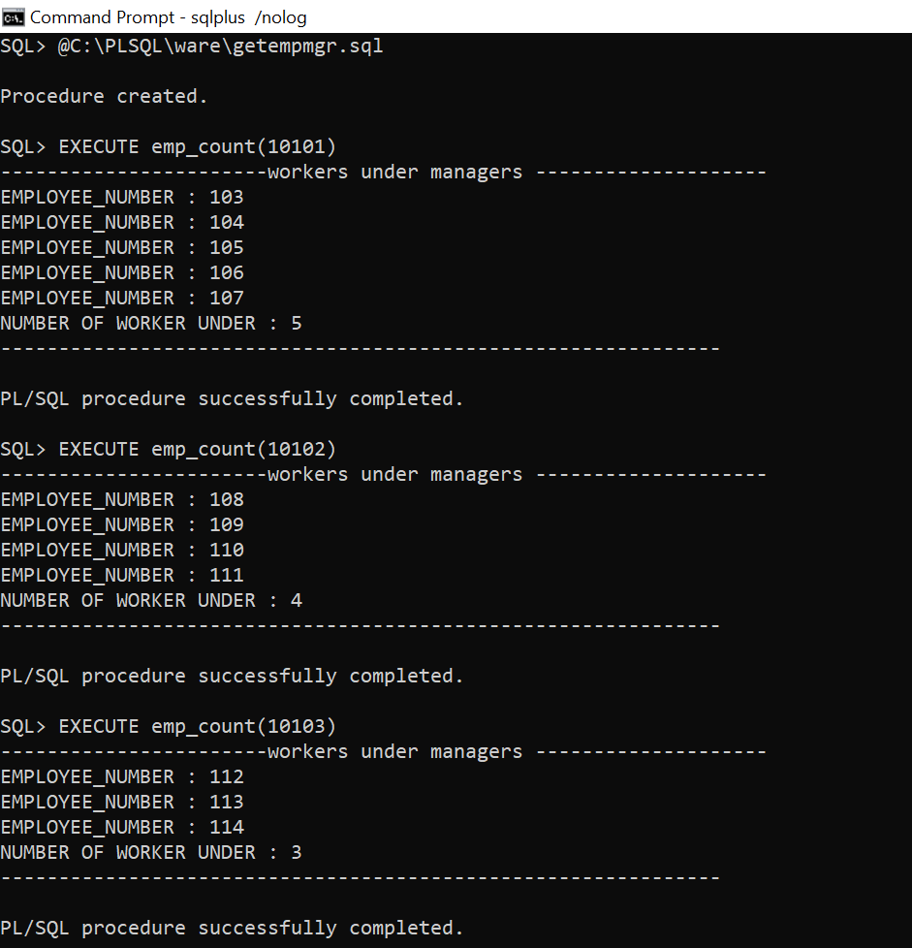
Create a procedure which gets all employee no, employee name for all the workers that work under a specific manager employee no is input to procedure.

Slide 23
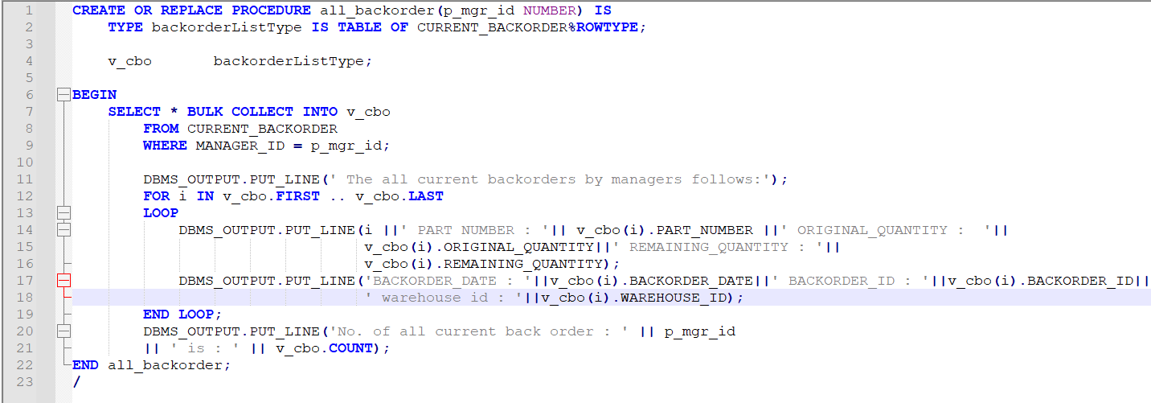
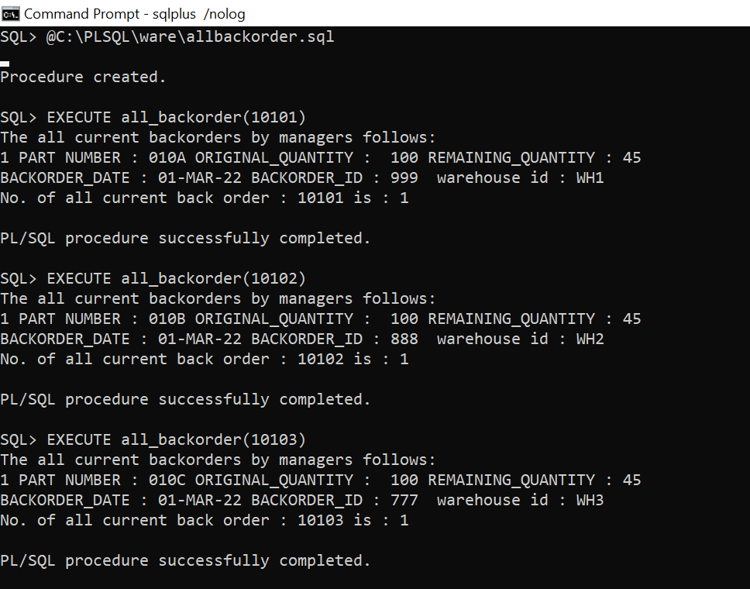
Create a procedure which gets list of all current backorders done by the manager employee no is input to procedure

Slide 24
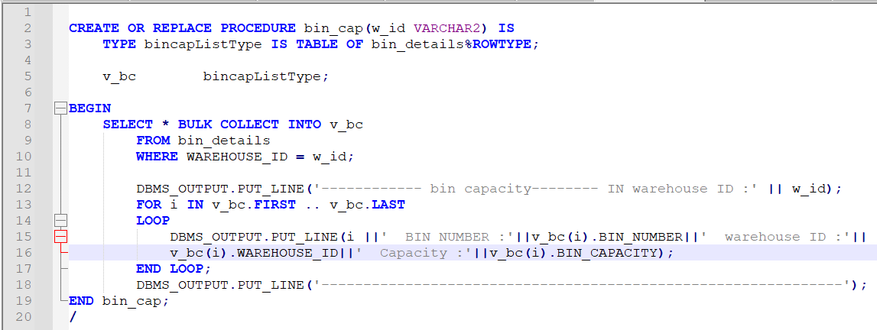
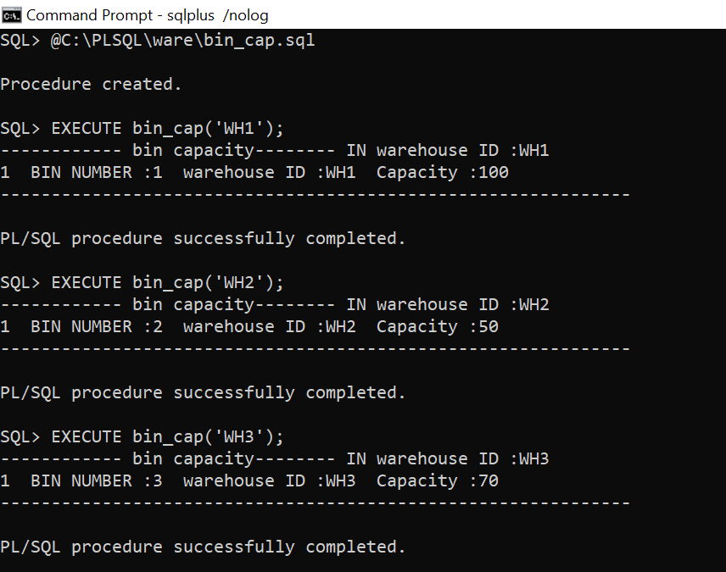
Create a procedure which for each warehouse bin, give the remaining capacity of the bin. Call the remaining capacity remaining_capacity.

Slide 25
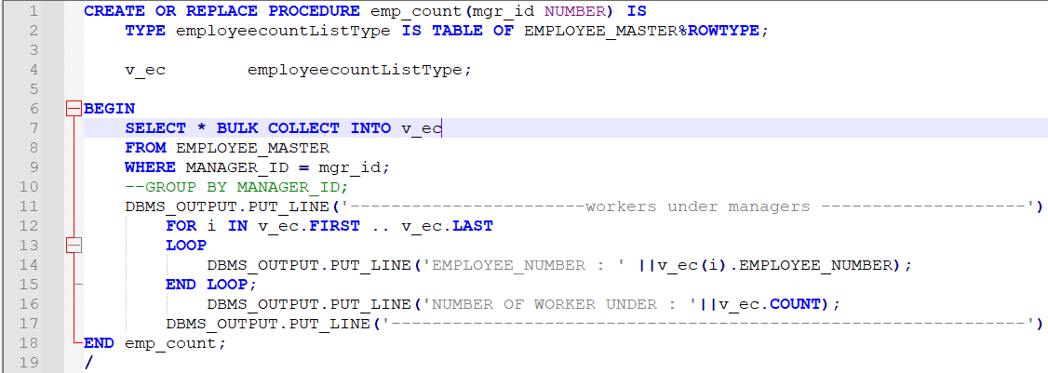
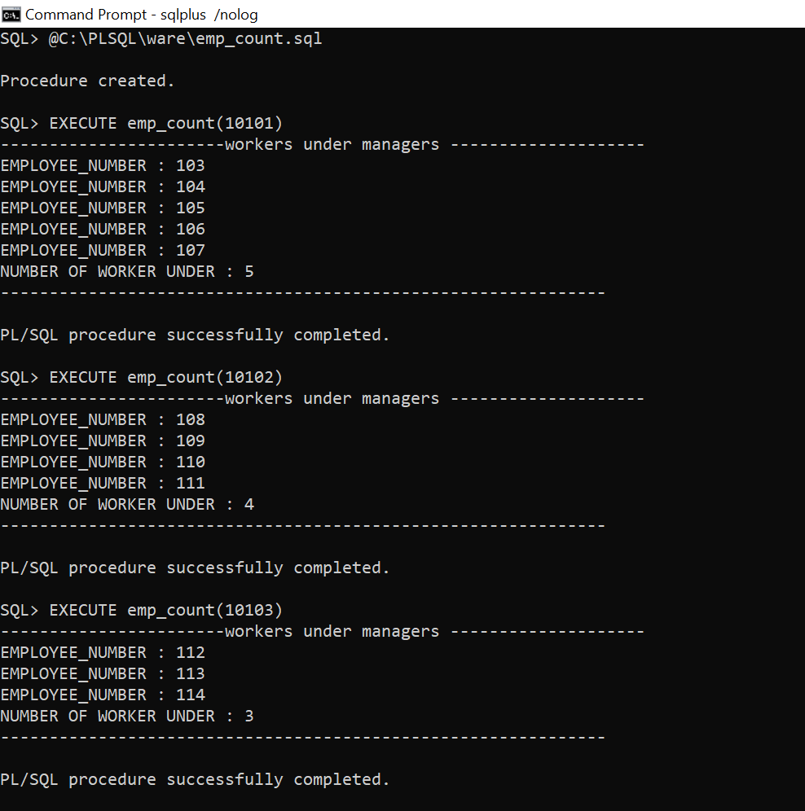
Create a procedure which returns Give employee_no and number of workers managed for all the managers with The smallest number of workers managed.

Slide 26
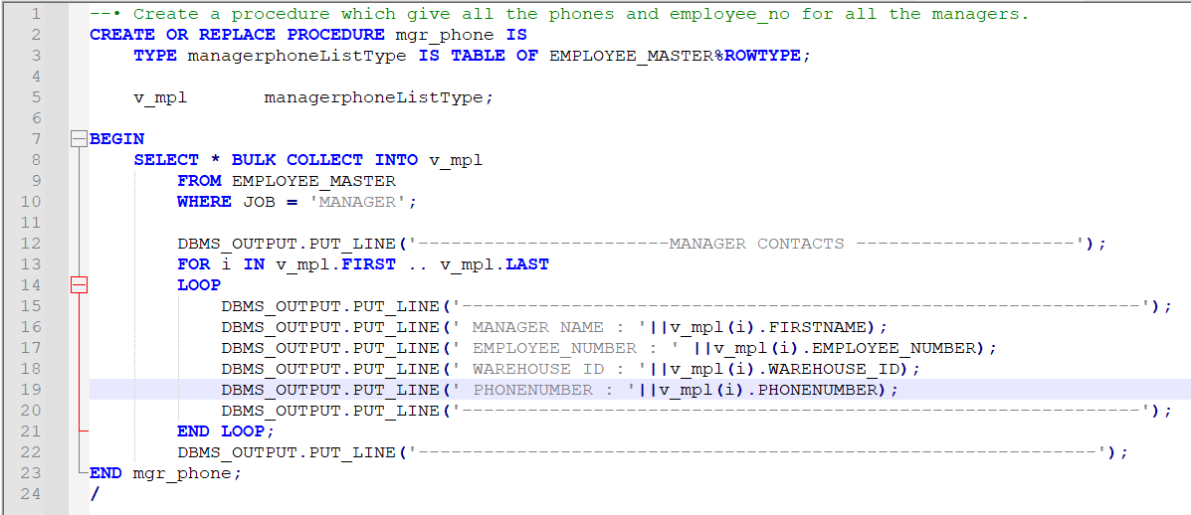
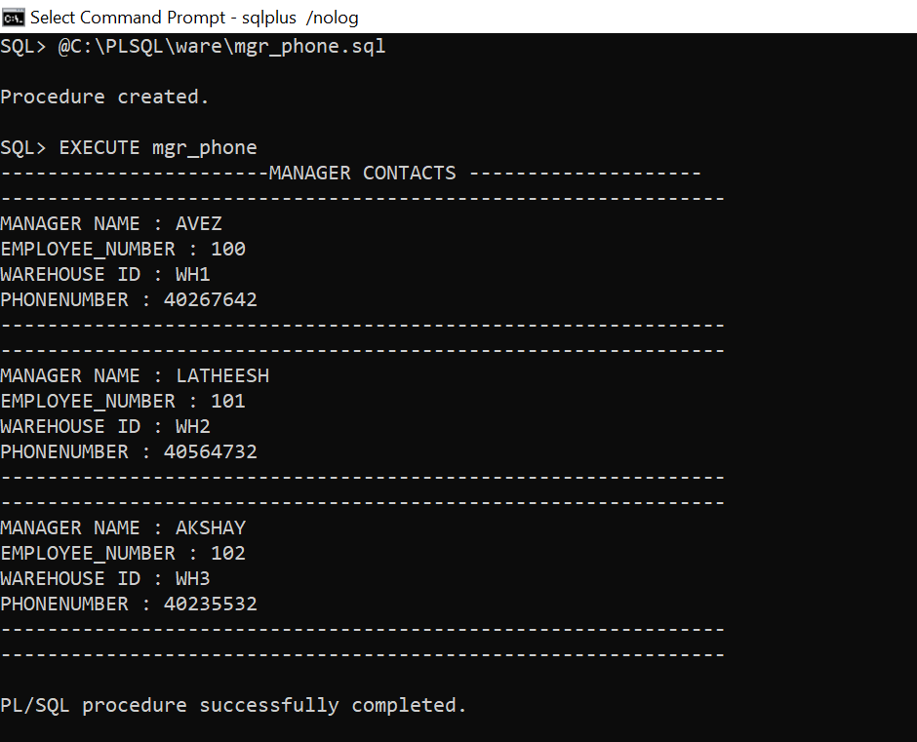
Create a procedure which give all the phones and employee_no for all the managers.

Slide 28
THANK YOU

